Slide 1


AGENT VIPER
(AI Assisted Pentest)
AI Workflow Engine for VULNERABILITY IDENTIFICATION AND
PENETRATION & REPORTING
Syed Ibrahim · ITS InfoSec Services
CISO Technical Review · Prototype Demo
Notes:
GM-
I will present - - working prototype.
AV, Helps – tester –by combine 3 – and AI-driven analysis to provide - broader attack surface – risk-prioritized – before manual test begins.
Platform – advisory only – generated results – validated, by the tester – before reporting.
Let me walk you through the solution ----

Slide 2
Agenda
About Agent Viper
What it is — inputs, workflow, outputs
Current Workflow vs Agent Viper
Side-by-side comparison — changes & improves
Agent Viper What It Covers & What It Doesn't
Clarifies what Agent Viper automates and what remains the responsibility of penetration testers
Guardrails & key Capabilities
Planned control & Key highlights
Prototype Results
Built, tested — 91 vulnerabilities, including 13 attack chains and14 critical advisories
Demo
Demo target, real tools, real reasoning
Notes:
overview 1– workflow ,to highlight what changes, – guardrails build into the platform–we will review the prototype –conclude with a live demo with demo target –
Let me move into next slide will see details.

Slide 3



ACCELERATING DELIVERY — INTELLIGENCE ON DAY ONE, NOT DAY THREE
Increased Scope Coverage — structured intelligence delivered on day one, not day three.
CURRENT WORKFLOW
Requestor raises
request
QC performs
validation
QC assign
PT case
Pentest
perform
Quality Advocates
Report
Delivery
In ReqIT
QC + creds
Scheduled
Starts on date
N+0
5.5 to 6 days
N+6 Days
AGENT WORKSTREAM
Requestor raises
request
QC validation
in GSN
Agent Scout
Recon phase
Agent Viper
Intelligence Analysis
Manual Validation
& Pentest
Perform
Quality Advocates
Report
Delivery
In ReqIT
QC + creds
40–80 min
3–6 hours
N+0
1 days
N+4 days total
Notes:
On the top – see – pentest perform - reconnaissance, analysis, and vulnerability correlation -
On the bottom → After the initial validation,
A Scout performs reconnaissance, and A Viper analyzes and correlates three data to
generate a risk-prioritized view of the application
before manual testing begins.
Testers – starts with –having more deti- attack surface, potential attack paths, and the highest-risk areas to investigate.
Generated possible findings - validate + pt perform include ( business logic + Idor + priv-escal ) – need human expertise
Shall I move to next slide.

Slide 4
Agent Viper: What It Covers & What It Doesn't
Agent Viper What It Does
Correlates Agent Scout, SAST, and DAST data to produce a unified, risk-prioritized attack surface.
Expands assessment coverage through automated correlation, VDP knowledge reuse, and runtime attack-vector mapping.
Generates actionable intelligence including attack paths, CVE enrichment, and validation test cases.
Accelerates penetration testing by reducing manual analysis and enabling testers to focus on high-risk validation.
Agent Viper What It Doesn’t Do
Does not confirm or exploit vulnerabilities—it generates possible findings and validation test cases; confirmation is performed manually.
Does not reliably identify business logic, IDOR, or application-specific authorization flaws without human expertise.
Does not perform autonomous penetration testing — The platform generates intelligence and validation guidance; testing actions remain analyst-driven.
Notes:
Left – capabilities –
Instead of looking separate - viper correlates three inpu– bring – together into a single view and correlates the findings using AI.
It *third* attack surface, attack paths,possible entry points while expanding *second*
This allows penetration testers to focus on validating the highest-risk scenarios.
Right side - boundaries ---
AV advisory only- “1”
2nd - which require human expertise and manual testing.
Provides – intelligence and assessment guidance – while validation and exploitation remain the responsibility of tester
Shall I move to next slide.

Slide 5

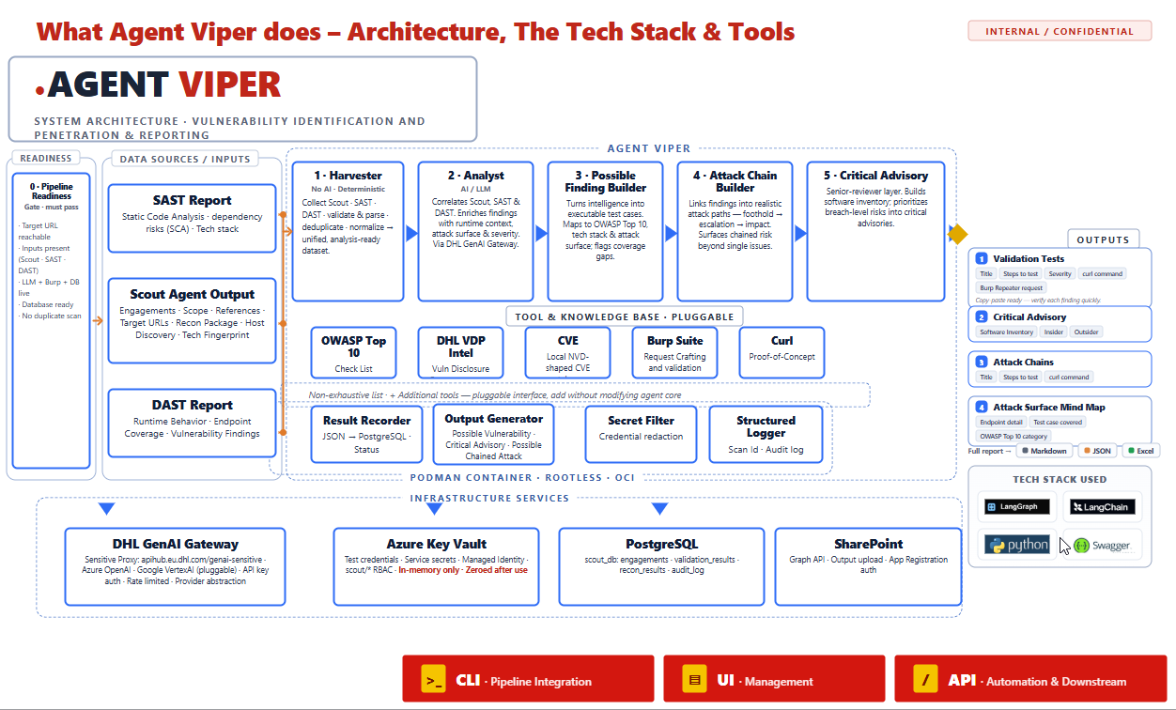
Notes:
Left pipeline starts - Readiness, where automated validation checks ensure the assessment can be executed safely, reliably, and within the approved scope.
Next are the Data Sources / Inputs. Once the readiness checks pass, the pipeline accepts Agent Scout, SAST, and DAST data.
These inputs are consolidated by the Harvester into a single, analysis-ready dataset.
In the center, the Analyst is the first AI-driven stage. It correlates and enriches the data, removes duplicates with AI match endpoints and vulnerability type, maps findings to runtime endpoints, and prioritizes risks.
Moving further, the Possible Finding Builder generates structured possible findings and validation test cases. The Attack Chain Builder combines related findings into realistic attack paths, while the Critical Advisory identifies the highest-impact risks, including potential breach scenarios and sensitive data exposure.
At the bottom, you can see the Knowledge Base, which includes OWASP Top 10, DHL VDP Intelligence, CISA KEV, NVD CVE intelligence, and predefined security testing checklists. These trusted knowledge sources help ground the AI's analysis, improve accuracy, and reduce hallucinations.
On the right, you can see the Outputs. The platform delivers a risk-prioritized attack surface, attack chains, critical advisories, and an Attack Surface Mind Map. All outputs are downloadable in Excel, with Markdown and JSON formats also supported.
***Overall, the platform provides broader attack-surface coverage, more consistent assessments, and earlier identification of high-risk issues. The objective is not to replace penetration testers, but to provide actionable intelligence so they can focus on validating the highest-impact risks from the beginning of the engagement.***
From an infrastructure perspective, Agent Viper aligns with the Scout project by reusing the same infrastructure, platform services, and operational model. This reduces implementation effort while providing a unified capability for reconnaissance, vulnerability intelligence, and attack-surface analysis.
Workflow - executed - through - CLI, - web UI, or as part of an automated workflow, - it enables more integration option..
Shall I move to next slide

Slide 6
Guardrails & key Capabilities
Scope Guard
Constrains pipeline execution strictly to authorized target scope — prevents unintended scanning.
Key Capabilities:
Dynamic SAST to attack vector mapping
Automated CVE enrichment via NVD + CISA KEV
VDP Intelligence & Pattern Reuse.
Broader Attack Surface Coverage
Automated Attack Chain Generation
LLM Token Execution Limits
Hard cap on token usage per execution. If the threshold is exceeded, the pipeline stops and displays the triggered guardrail, scan ID, and event details in the monitoring dashboard.
Kill Switch
Instant termination of full pipeline execution — admin can stop and debug at any point.
Credentials Isolation
Credentials are never exposed to the LLM — secrets stripped before every agent call; tools usage will use credential from database.
Notes:
On the left:
Scope Guard restricts execution strictly to the authorized assessment scope, preventing unintended scanning of out-of-scope targets.
LLM Token Execution Limits enforce a predefined token threshold for each execution. If the limit is exceeded, the pipeline stops automatically, and the event is recorded in the monitoring dashboard for administrator review.
The Kill Switch allows administrators to immediately stop the entire pipeline at any stage for troubleshooting, validation, or investigation.
Finally, Credential Isolation ensures that credentials, API keys, and tokens are never exposed to the LLM. All sensitive information is securely managed by the platform before any AI processing takes place.
All guardrails operate at the scan level, stopping only the affected scan. The only exceptions are the manual Kill Switch and the LLM Token Execution Limit, which halt the entire platform by stopping all running scans and pipeline activities.
On the right, you can see the platform's key capabilities.
Dynamic SAST-to-Attack Vector Mapping maps static SAST findings to runtime endpoints, enabling faster and more accurate vulnerability validation.
Automated CVE Enrichment verifies AI-generated findings against NVD and CISA KEV, enriching them with real-world threat intelligence and known exploited vulnerabilities.
VDP Intelligence & Pattern Reuse reuses historical VDP findings to identify similar attack patterns and generate targeted validation test cases.
Broader Attack Surface Coverage correlates Agent Scout, SAST, and DAST into a unified intelligence view, improving coverage and identifying compound risks.
Automated Attack Chain Generation connects related vulnerabilities into realistic attack paths, demonstrating potential business impact and breach scenarios.

Slide 7
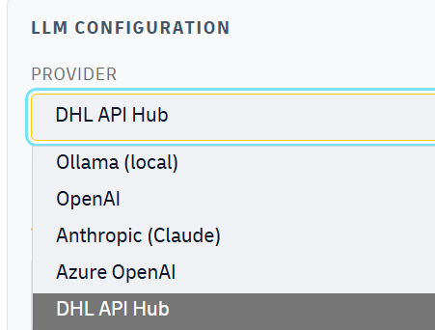
Prototype Results
LLM CONFIGURATION
SCOUT INPUT
15
ENDPOINTS
17
FINDINGS
AGENT VIPER
19
ENDPOINTS DISCOVERED
Scout Input
19 total — 4 newly discovered during scan
91
POSSIBLE FINDINGS
Master set — Attack Chains & Critical Advisory & scout Finding Advisories are subsets
13
ATTACK CHAINS
14
CRITICAL ADVISORY
14
CRITICAL ADVISORY
13
ATTACK CHAINS
Subset of 91 master set
Subset of 91 master set
10
BREACH-LEVEL ADVISORIES
4
KNOWN EXPLOITED CVES
Security By Design
10
VIPER DELIVERS
75%
PENTESTER FOCUS AREA
The 219 total findings include 13 attack chains and 14 critical advisories (10 breach-level risks and 4 CVE-matched threats)—these are the areas pen testers should focus on.
Viper transforms Scout output by extending attack surface coverage and delivering a prioritised assessment before manual testing begins.
Confirmed Findings
Security by Design – Continuous SAST, DAST, Threat Modeling
Notes:
Starting on the left, the assessment began with 15 Scout-discovered endpoints and 17 Scout findings, which served as the initial input for the analysis.
Agent Viper expanded the attack surface by discovering 19 endpoints, including 4 additional runtime endpoints, and generated a total of 91 possible findings. This master set includes Attack Chains, Critical Advisories, and Scout Advisories.
From these findings, the platform identified 13 attack chains and 14 critical advisories, including 10 breach-level scenarios and 4 findings matched against known exploited CVEs.
On the right, these prioritized results become the primary focus areas for penetration testers, enabling them to concentrate on validating the highest-risk scenarios instead of spending time manually correlating data.
Overall, Agent Viper transforms the initial Scout output into a broader attack surface, prioritized security intelligence, and actionable attack paths, providing valuable insights before manual penetration testing begins.
The platform provides **LLM flexibility**, using the **DHL API Hub** as the default provider for compliance while also supporting **Ollama** local deployments, as well as **others** for deployment flexibility.
From an engineering perspective, the solution currently maintains approximately **75% code coverage** and is continuously validated through **SAST** and **DAST** adn threat mdeling testing.

Slide 8
LIVE DEMONSTRATION
Notes:
Admin creds :- Username: admin@agentviper.local
Password: Harbor-Quartz-Meadow-58

